Slide 1
AUTOMATIC FAN SPEED CONTROLLER
r.vijayeeshwar-22ag1a6949
j.Niharika-22ag1a6923 internal guide
k.Jaydeep-22ag1a6925 v.veeresh sir

Slide 2
Abstract
Introducing Automatic Fan Speed Controller,this project is a standalone automatic fan speed controller that controls the speed of an electric fan according to our requirement based on temperature .
In these project we use breadboard, LCD display, I2c maodule, Aurdino Uno board, jumper wires, temperature sensor, motodriver.The sensed temperature and fan speed level values are simultaneously displayed on the LCD panel. A temperature sensor has been used to measure the temperature of the room and the speed of the fan is varied according to the room temperature.
The temperature-based fan speed control system can be done by using an electronic circuit using an Arduino board.Now Arduino board is very progressive among all electronic circuits, thus we employed Arduino board for fan speed control.
The proposed system is designed to detect the temperature of the room and send that information to the Arduino board. Then the Arduino board executes the contrast of current temperature and set temperature based on the inbuilt program of the Arduino.

Slide 3
Literature Survey
A literature survey on automatic fan speed controllers based on temperature reveals a diverse range of approaches, technologies, and applications across various fields. Here’s a concise overview based on existing research and developments:
1. Sensor Technologies: Various temperature sensing technologies are utilized in automatic fan speed controllers. Common sensors include thermistors, which offer cost-effective temperature measurement with good accuracy and response time. Additionally, digital temperature sensors like DS18B20 and LM35 provide precise digital outputs, suitable for interfacing with microcontrollers.
2. Control Algorithms: Several control algorithms are employed to adjust fan speed based on temperature readings. Proportional-Integral-Derivative (PID) control is widely adopted due to its ability to respond smoothly to changes in temperature and maintain stability. Adaptive algorithms, such as fuzzy logic and neural networks, are also explored to optimize fan speed adjustments under varying environmental conditions.

Slide 4
Literature Survey(continue)
3. Hardware Implementations: The implementation of automatic fan speed controllers typically involves microcontrollers or dedicated fan control ICs. Microcontrollers such as Arduino and Raspberry Pi are popular choices due to their versatility and ease of integration with sensors and actuators. Fan control ICs like the LM96000 series provide dedicated hardware solutions for precise fan speed regulation based on temperature inputs.
4. Applications: Automatic fan speed controllers find applications in diverse industries. In computing, these controllers are crucial for maintaining optimal operating temperatures in CPUs and GPUs. They are also used in industrial equipment, HVAC systems, and home appliances to improve energy efficiency and equipment longevity. Automotive applications focus on cooling electronics and batteries in electric vehicles to enhance performance and safety.

Slide 5
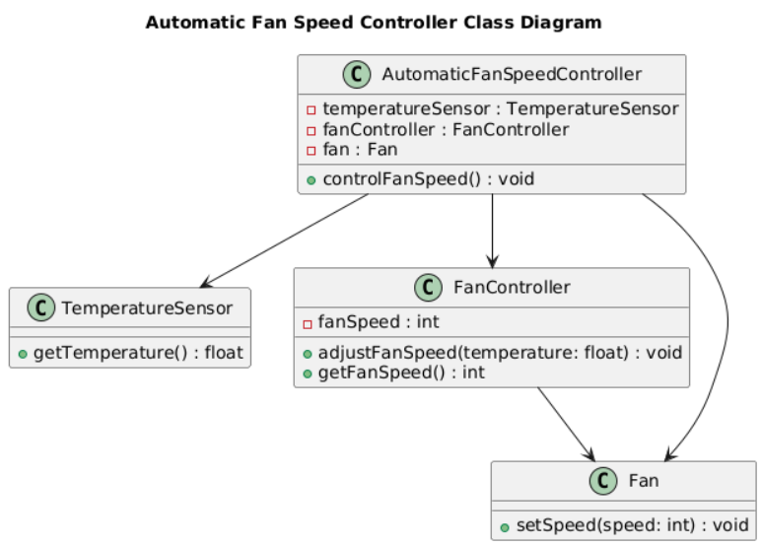

Slide 6
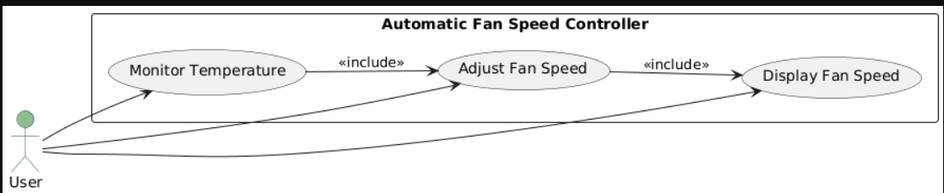

Slide 7
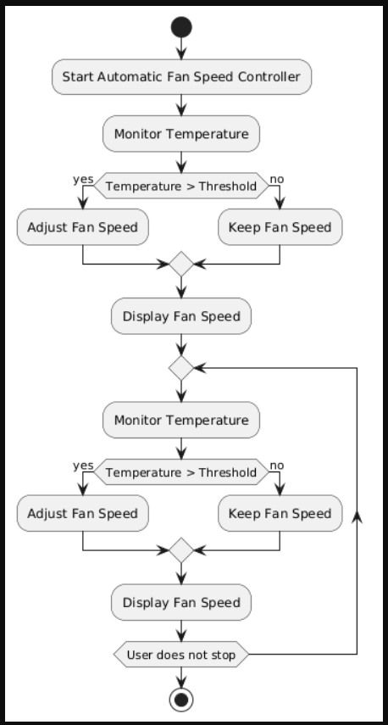

Slide 8
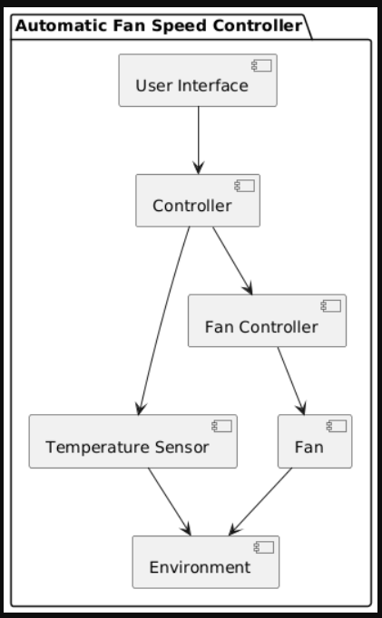

Slide 9
Implementation Code
#include <Adafruit_Sensor.h>
#include <DHT.h>
#include <DHT_U.h>
#include <Wire.h>
#include <LiquidCrystal_I2C.h>
#define DHTPIN 7 // DHT11 sensor data pin
#define DHTTYPE DHT11 // DHT sensor type
#define MOTOR_PIN_ENA 9 // Enable pin for motor driver (PWM pin)
#define MOTOR_PIN_IN1 10 // Input pin 1 for motor driver
#define MOTOR_PIN_IN2 11 // Input pin 2 for motor driver
#define TEMPERATURE_THRESHOLD 29
#define TEMPERATURE_THRESHOLD1 32 // Temperature threshold to adjust motor speed

Slide 10
Implementation Code(continue)
DHT dht(DHTPIN, DHTTYPE);
LiquidCrystal_I2C lcd(0x3F, 16, 2); // Adjust the I2C address if necessary
void setup() {
Serial.begin(9600);
dht.begin();
Wire.begin();
lcd.init();
lcd.backlight();
lcd.begin(16, 2);
lcd.setCursor(0, 0);
lcd.print("Temperature:");}

Slide 11
Implementation Code(continue)
void loop() {
delay(2000); // Delay between readings (adjust as needed)
float temperature = dht.readTemperature(); // Read temperature in Celsius
if (isnan(temperature)) {
Serial.println("Failed to read temperature from DHT sensor!");
return;
}
Serial.print("Temperature: ");
Serial.print(temperature);
Serial.println(" °C");
lcd.setCursor(0, 1); // Set cursor to the second line
lcd.print(" "); // Clear the previous motor speed

Slide 12
Implementation Code(continue)
// Adjust motor speed based on temperature
if (temperature > TEMPERATURE_THRESHOLD1) {
// Increase motor speed
analogWrite(MOTOR_PIN_ENA, 255); // Set the motor speed to maximum (255)
digitalWrite(MOTOR_PIN_IN1, HIGH); // Set motor direction (forward)
digitalWrite(MOTOR_PIN_IN2, LOW);
lcd.setCursor(0, 1);
lcd.print("Motor Speed: Max");
}
else if (temperature > TEMPERATURE_THRESHOLD) {
// Increase motor speed
analogWrite(MOTOR_PIN_ENA, 100); // Set the motor speed to a value (150)
digitalWrite(MOTOR_PIN_IN1, HIGH); // Set motor direction (forward)
digitalWrite(MOTOR_PIN_IN2, LOW);
lcd.setCursor(0, 1);
lcd.print("Motor Speed: Med");}

Slide 13
Implementation Code(continue)
else {
// Decrease motor speed
analogWrite(MOTOR_PIN_ENA, 45); // Set the motor speed to a lower value (150)
digitalWrite(MOTOR_PIN_IN1, HIGH); // Set motor direction (forward)
digitalWrite(MOTOR_PIN_IN2, LOW);
lcd.setCursor(0, 1);
lcd.print("Motor Speed: Low");
}
lcd.setCursor(12, 0); // Set cursor to the temperature position on the first line
lcd.print(temperature); // Print temperature
}

Slide 14
Conclusion
In conclusion, the automatic fan speed controller based on temperature offers significant advantages in terms of comfort, energy efficiency, and convenience. By automatically adjusting fan speeds according to real-time temperature fluctuations, it optimizes cooling efficiency while minimizing energy consumption. The controller's ability to maintain a desired temperature range enhances user comfort, ensuring a pleasant environment without the need for manual adjustments.

Slide 15
THANK YOU

